Slide 1

Welcome to:
Open Forum
6 PM Wednesday, April 4, 2018
Broun Hall, Room 235

Slide 2







Meeting Agenda

Slide 3
About SPARC

Slide 4
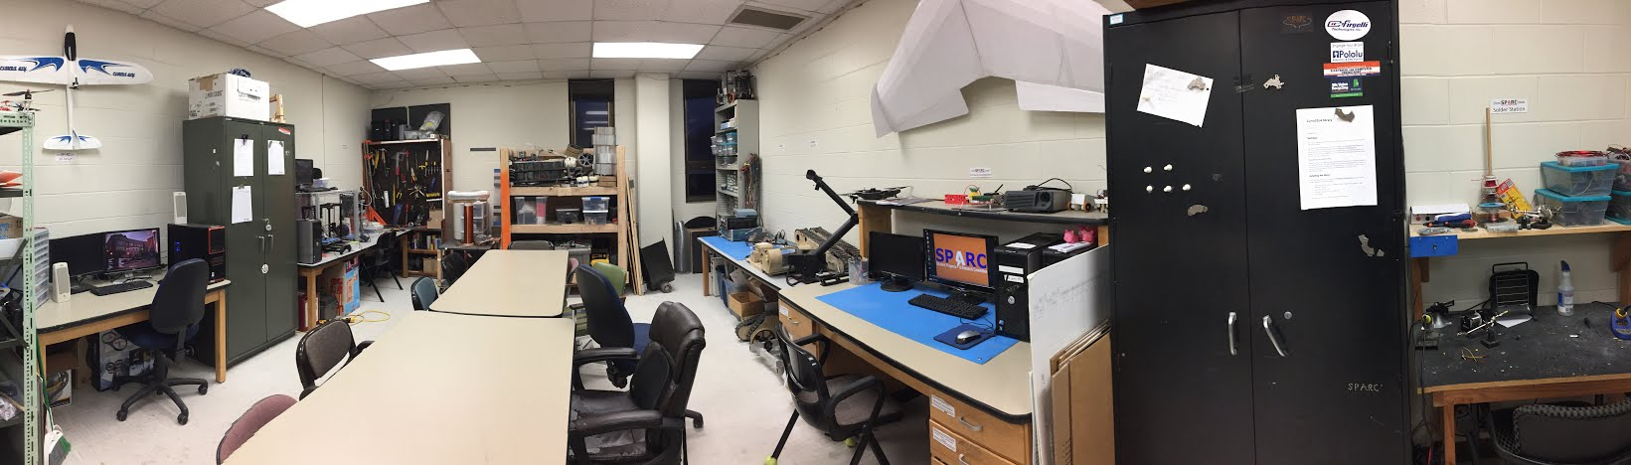
About SPARC
Creates and fosters an environment of creativity and innovation through collaborative projects.
A place to test out ideas, integrate concepts learned in class, and learn skills that will be instrumental when working in the workforce.
No prior experience is required, only a willingness to learn.
Join by logging 5 constructive hours in the lab on clipboard next to door and email sparc.auburn@gmail.com.
Lab:
- Broun 367
Maker Training Session:
- Tuesdays @ 5:30 in Broun 235
Open Forum:
- Wednesdays @ 6 in Broun 235

Slide 5


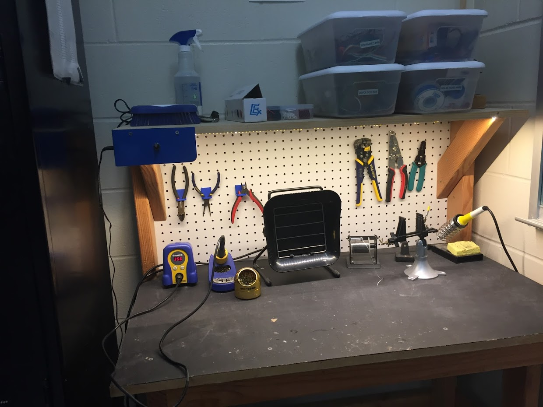
Our Lab
Broun Hall
Room 367

Slide 6
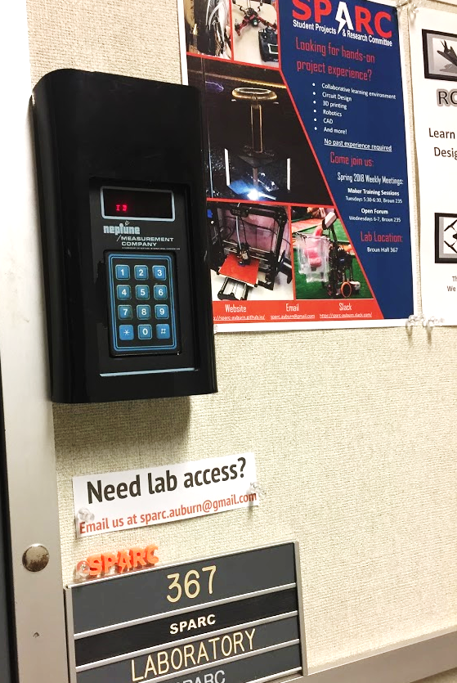
How to become a Member
Log 5 constructive hours in the lab
Write the times on the sheet on the clipboard next to the door.
Contact us at sparc.auburn@gmail.com
We will respond with the instructions to get an access code.

Slide 7
SPARC Meetings
Open Forum
Discuss status of active projects
Learn about and discuss specific topic in the realms of technology, engineering or making.
Wednesdays at 6:00 PM
Maker Training Session
Learn about a specific skills like 3D printing, CAD, electrical prototyping, and robotics.
Centered around SPARC Sumo Bot Competition
Tuesdays at 5:30 PM
Project Meetings
Project members come together to talk about detailed progress.
Meeting times and locations vary from project to project.

Slide 8




More Information about SPARC
Website
http://sparc.eng.auburn.edu/
Github
https://github.com/SPARC-Auburn
Slack
https://sparc-auburn.slack.com/
Email
sparc.auburn@gmail.com

Slide 9



Partner Organizations
NASA Robotics Mining Competition Team
President: Jeremy Frasher <jjf0010@auburn.edu>
RC Hobbyist Club
President: Craig Legrand <cbl0019@auburn.edu>
Meets on Mondays 3:30-4:30, SPARC Lab
Fridays 3:30-5:00, Broun 235
IEEE Auburn University Student Branch
President: Michelle Kniffen <mek0027@auburn.edu>
Meets on announced Mondays, Broun 238

Slide 10
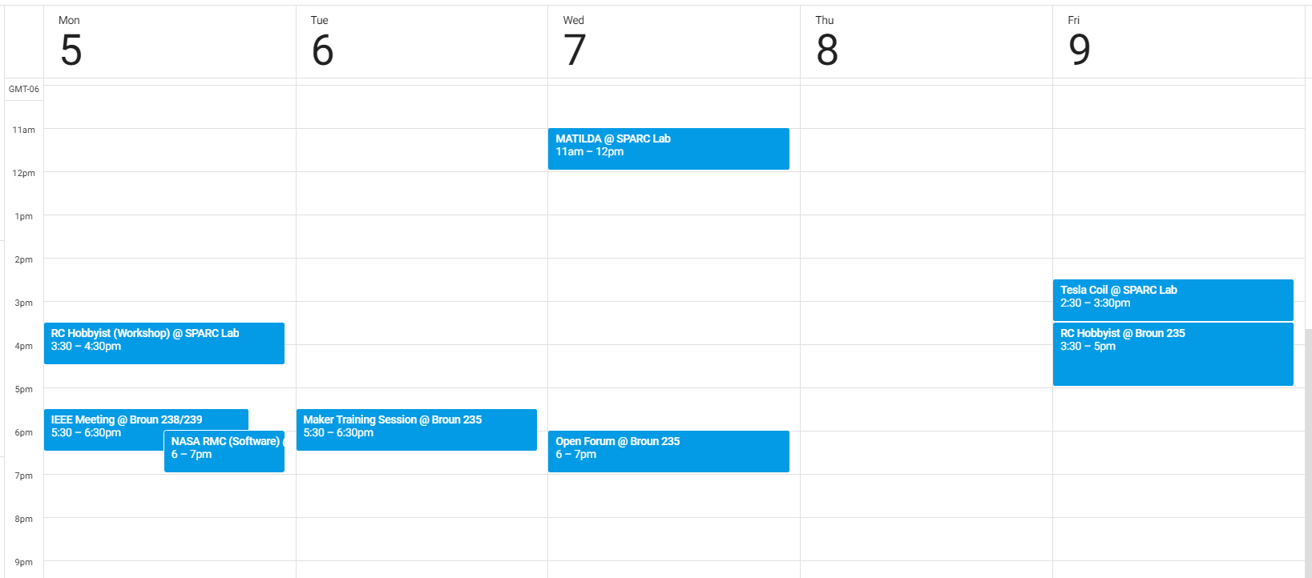
Meetings this Week

Slide 11
Outreach

Slide 12
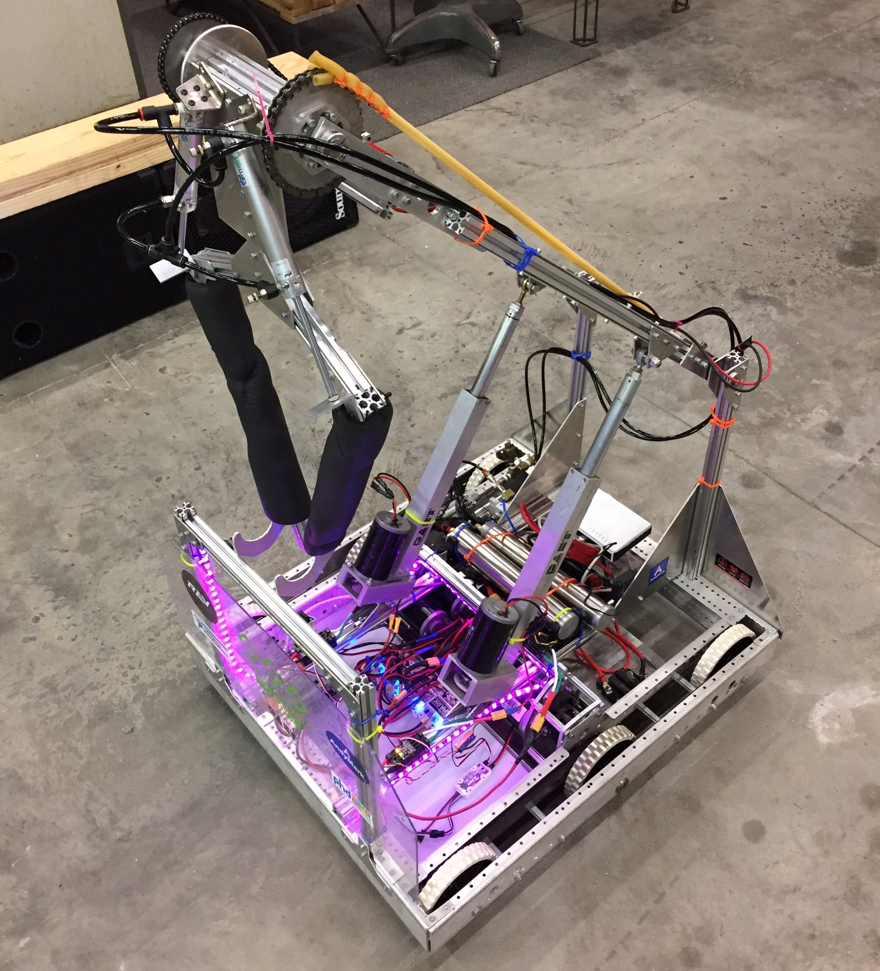
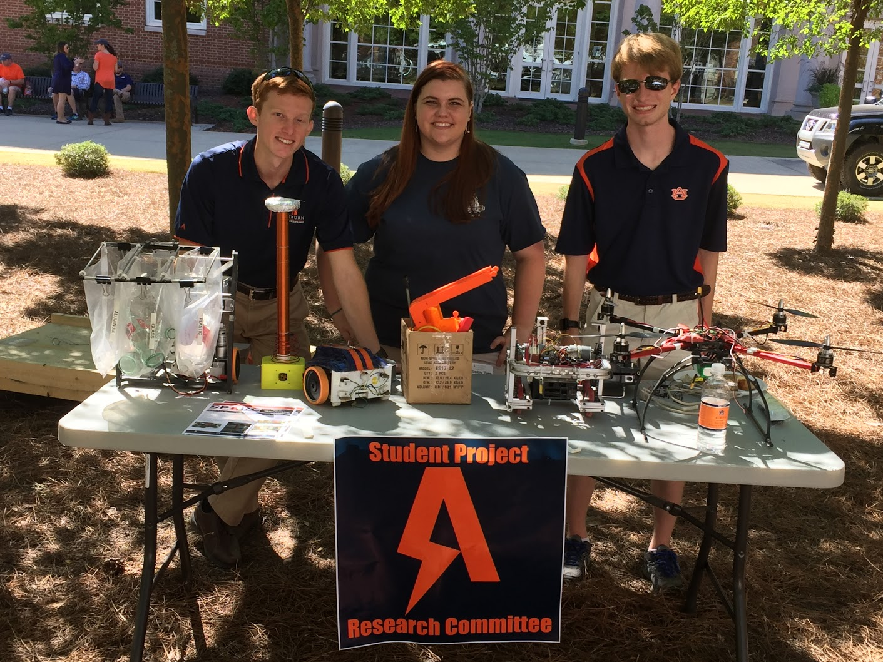
Outreach Events
PEAK
After school camp for 3rd – 5th graders to learn about engineering on Auburn’s campus
4 open 1 hour slots for electrical engineering demonstration
Takes place on the afternoon of Wednesday, April 11th.
Contact us at sparc.auburn@gmail.com for more information.
Robot in 3 Days 2018 Bot
Engineering Tailgate 2016 SPARC Table
Notes:
Fall 2016
Loachapoka Robotics Mentoring- Mondays, Tuesdays, and Thursdays 3:00PM to 4:30PM
ECE Minority Presentation- November 14th
AJHS E-Day- November 17th
South’s Best- December 3-4th
SCORE Claw Machine- December 3-4th
Spring 2016
E-Day- Late February or early March
SPACE Day- Possible Event Next Semester
IEEE Sumo Robotics Competition (with local middle and high schools)- Spring 2017

Slide 13
Projects

Slide 14
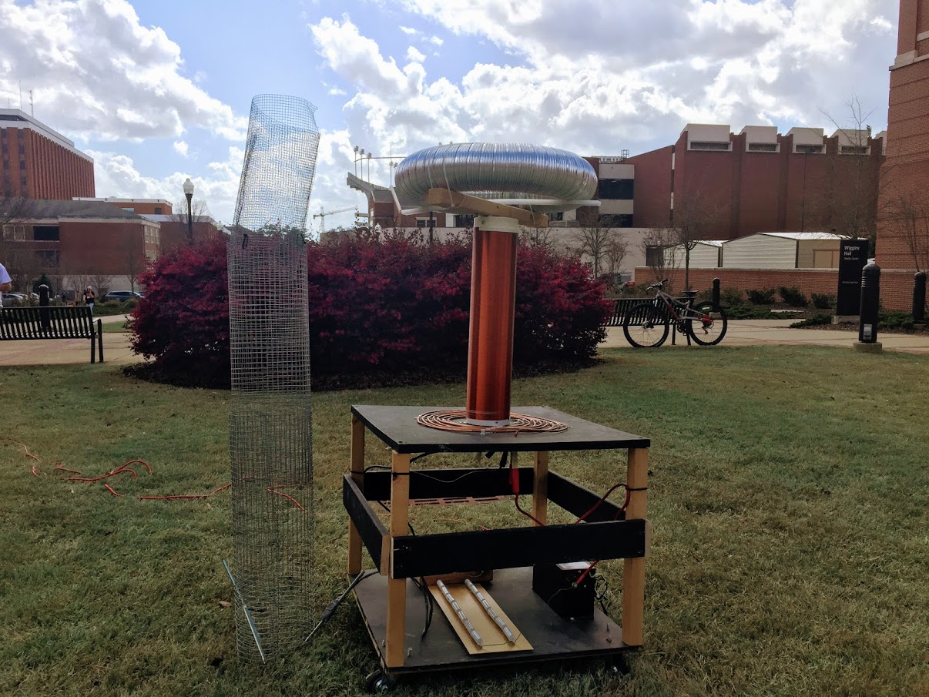
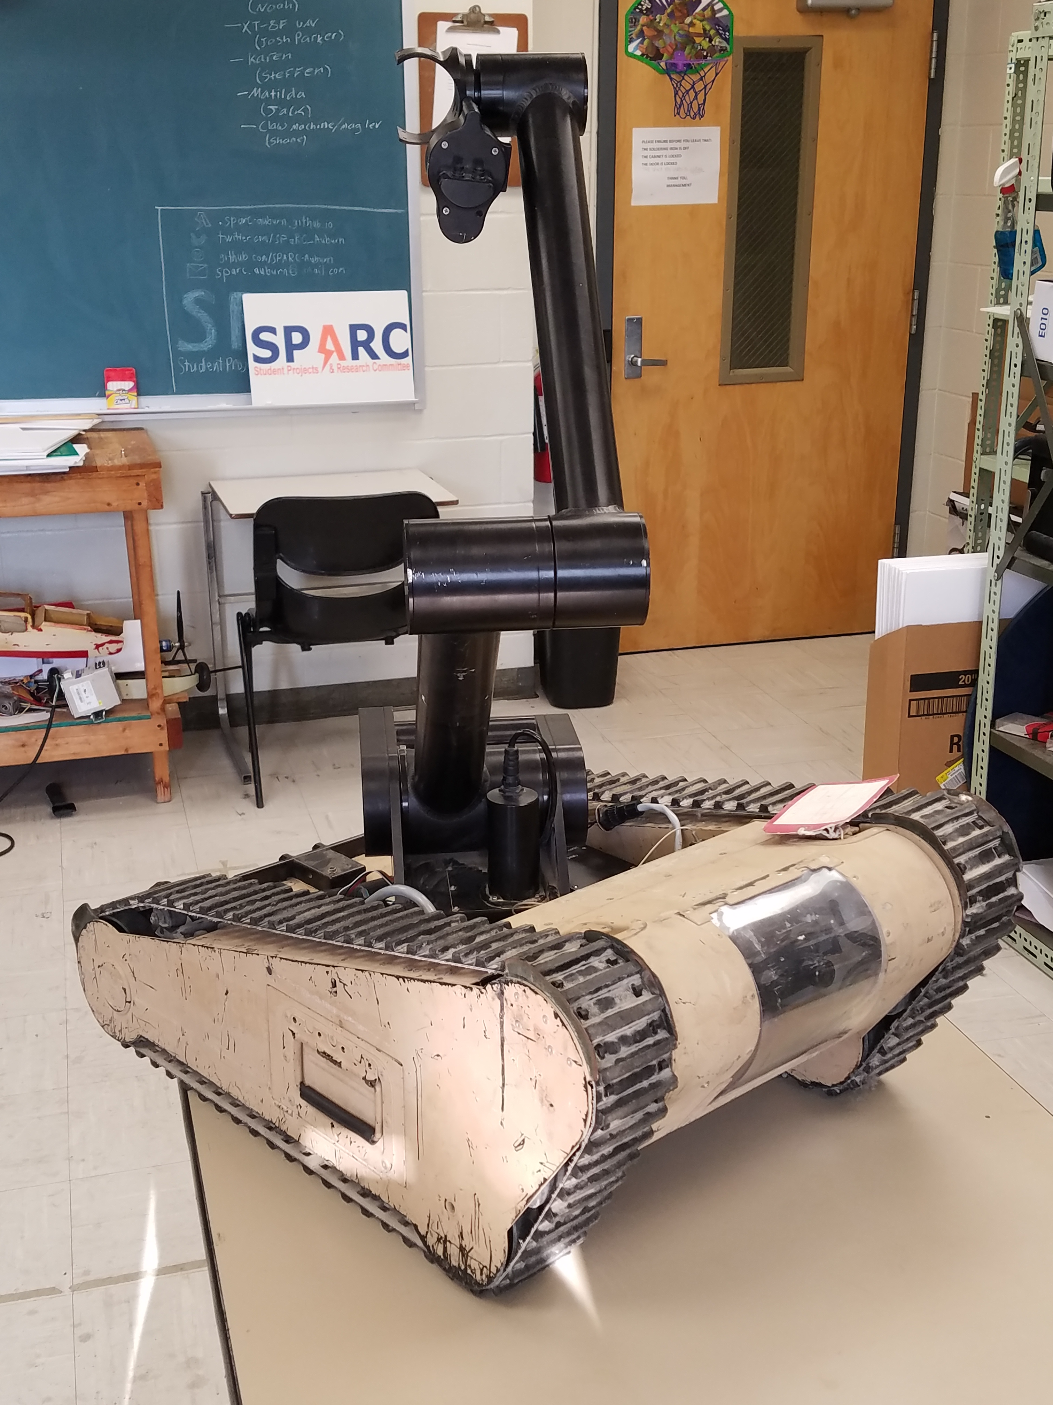
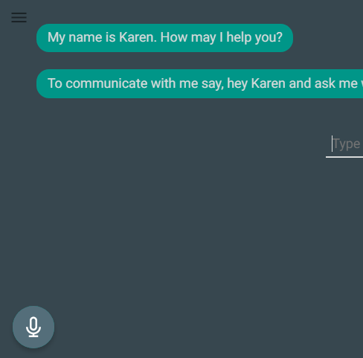
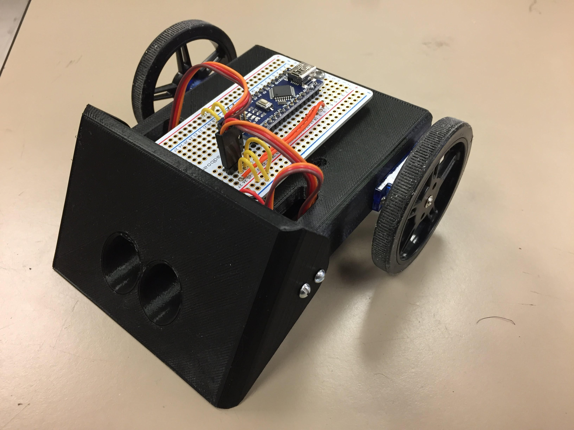
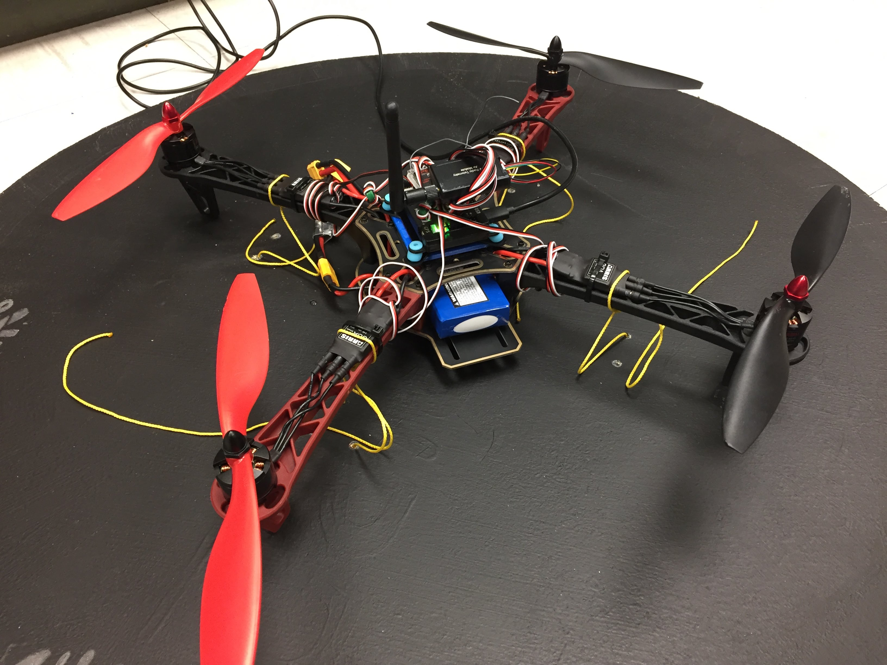
Spring 2018 Main Projects
MATILDA Robotics Platform
Tesla Coil
Lab Assistant
Lab Assistant
Unmanned Aerial Systems

Slide 15
Project: MATILDA
Project lead: Jack Thomas
Slack Channel: #projectmatilda
MATILDA stands for Mesa Associates' Tactical Integrated Light-Force Deployment Assembly
A bomb disposal robot from Dr. Roppel’s research lab.
Is in disrepair both electrically and mechanically.
Semester Focus
Reestablishing mobility.
Reestablish arm control
Meeting Time
Wednesdays at 11:00 AM in SPARC Lab

Slide 16
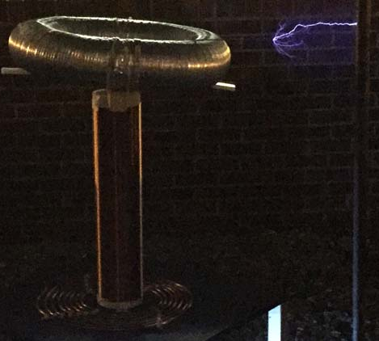
Project: Tesla Coil
Project lead: Adam Haverkamp
Slack Channel: #projectteslacoil
Demonstrated Tesla Coil at Spring 2016 E-Day
Use spark gap style circuitry
Generated estimated 400,000 volts of electricity.
Semester Focus:
Make it operational again (new capacitors)
Potentially convert it into a musical Tesla Coil.
Meeting Times
TBD

Slide 17
Project: Unmanned Aerial SysTems
Project lead: Mike Petry
Slack Channel: #projectuas
Partnership with RC Hobbyist Club
SPARC owns two quadcopter frames.
Will be used to experiment with many applications
Autonomy- search and follow
Camera Gimbal- stable video capture
Payload- pickup, identification, and delivery
Semester Focus
Get at least one frame flying
Start looking into camera gimbal
Meeting Times
TBD

Slide 18
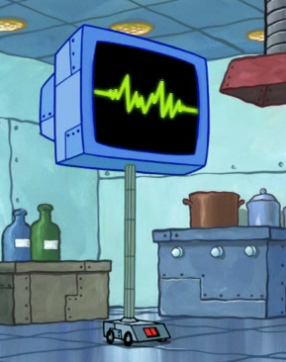
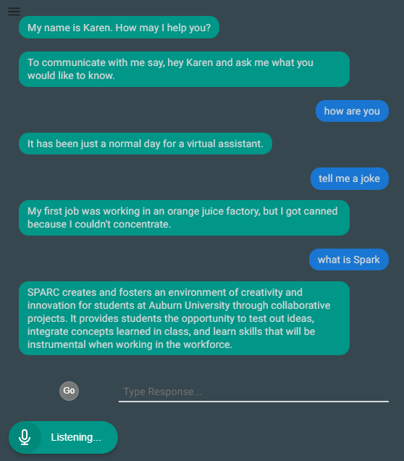
Project: Lab Assistant
Kinematic
Autonomous
Robot
Enriches
Newcomers
Create an automated lab assistant.
Will be voice controlled.
Will consist of both a stationary and mobile system.
Will be embedded on the new group chat system Slack.
Programmed in Node.JS (Framework of JavaScript)
Semester Focus
Solidify base framework
Create device/client server control mechanism
Slack Channel
#projectlabassistant

Slide 19
Project: Sumo Bot Tournament
Project lead: Matthew Castleberry
Slack Channel: #projectsumobot
Will be the final project for the Maker Training Sessions.
Attendance at Maker Training Sessions are not required to compete.
Will utilize many different topics in engineering
mechanical design
3D printing
electrical prototyping
sensor and control systems
C programming
Meeting Time
Tuesdays at 5:30 PM in Broun 367

Slide 20
Sumo Robotics Tournament

Slide 21
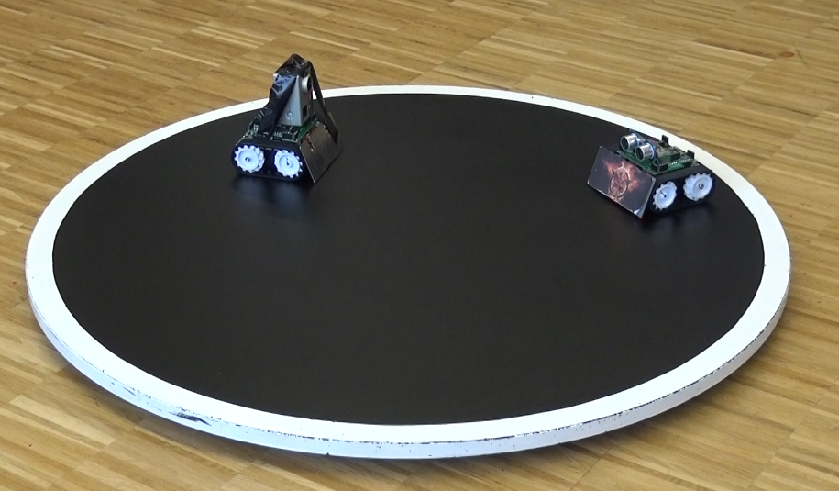

What is a Sumo Bot Competition?
Two robots are placed in a ring
Goal: attempt to push each other outside of ring.
Typically autonomous
First robot that touches outside of the ring loses the round.
The competitions “are non-destructive, family friendly, and great learning experiences.”
Competition will be on April 17, 2018 at 5:30PM
More information: http://www.robotroom.com/SumoRules.html
https://mcuoneclipse.com/2014/12/21/sumo-with-gopro-and-other-sumo-videos/
Mini Class
Japanese Class

Slide 22

SPARC Sumo-Bot Competition
Weight Constraint: < 750g(1.65lbs)
Size Constraints (at start of round)
Width: 15cm (5.91”)
Length: 15cm (5.91”)
Height: $∞$
Robots must not
Emit smoke or fire
Leak, stain, or soil
Disperse powder, grit, or grime
Spray, throw, or use projectiles
Jam, shock, or electromagnetically interfere
Snare, entangle, or employ nets/rope
Scratch, gouge, or scrape
Have sticky/magnetic/suction wheels
Competition Date:
Tuesday, April 17, 2018
5:30 PM in Broun Hall
Teams
Teams can consist of 1-3 members

Slide 23
SPARC Competition Part Constraints
up to 3 micro continuous servos
up to 2 servo wheels
all mechanical frame must be 3D printed
no sheet metal or raw plastics allowed
use any screws, nuts, washers
use Arduino Nano (clones), protoboard, wires, etc.
up to 2 Ultrasonic sensors
up to 4 line following sensors

Slide 24
Statistics for Spring 2018

Slide 25
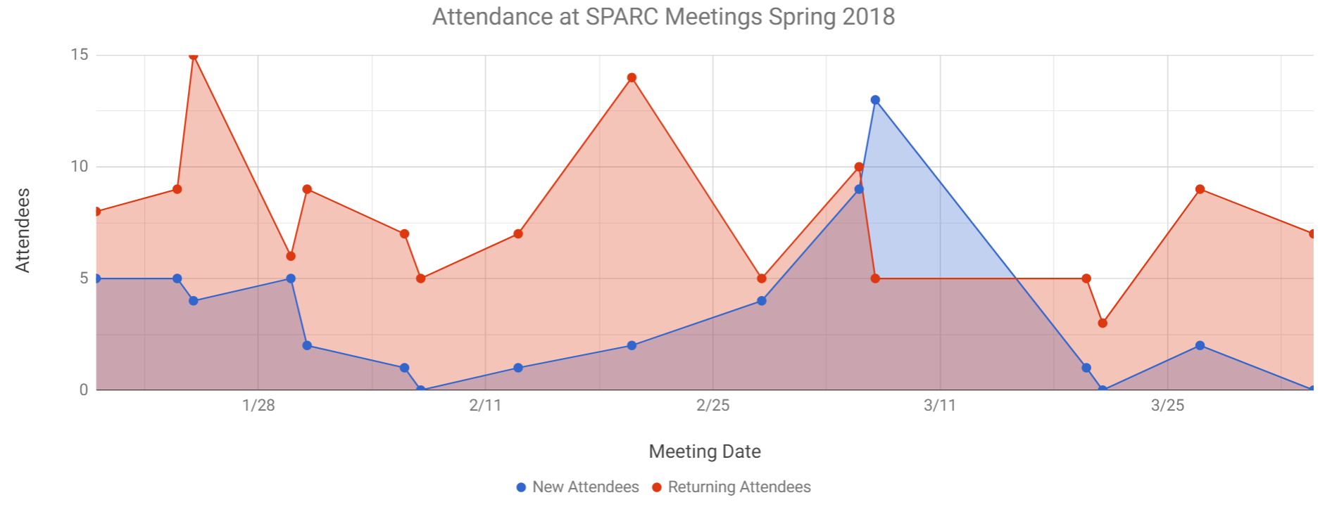
Attendance for Spring 2018

Slide 26
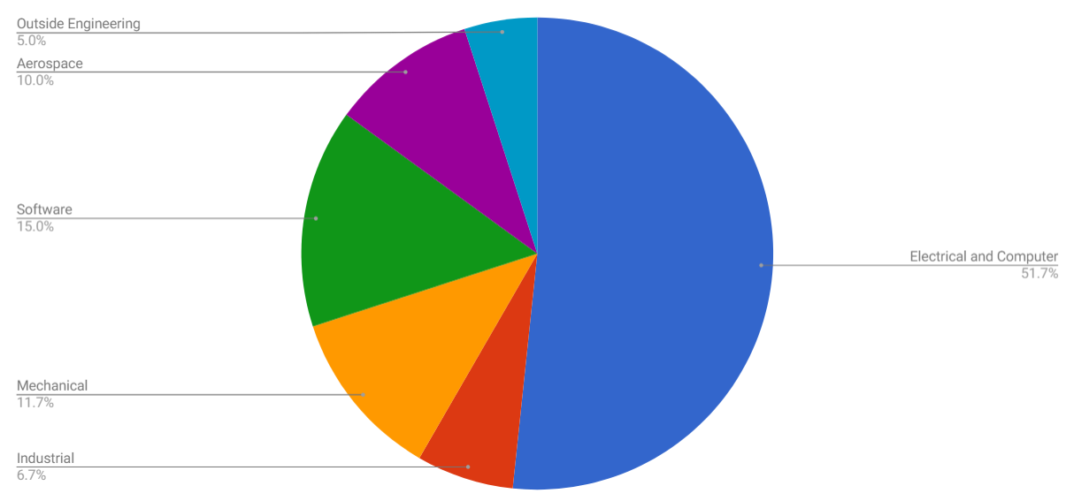
Distribution of SPARC Members (60 members)

Slide 27
Leadership for Fall 2018

Slide 28
Officer Positions
Current Positions:
President
Vice President
Lab Manager
Outreach Coordinator
Secretary
Treasurer
Proposed Positions:
President
Vice President
Director of Lab Operations
Director of Outreach
Director of Marketing and Recruitment

Slide 29
Officer Roles
Director of Lab Operations (a.k.a Lab Manager/Treasurer) Keeps lab running smoothly Identifies equipment needs Maintains 3D printers Organizes lab cleanup days Keeps track of expenses Ensures project and parts storage is well organized
Director of Outreach (a.k.a. Outreach Coordinator) manages outreach events: E-Day, robotics team mentoring, volunteer opportunities, demonstration tables Helps connect members to outreach activities keeps track of student service hours
Director of Marketing and Recruitment manages website, flyers, white board announcements, etc. must know or be able to learn HTML teaches members how to give a good lab tour Works with outreach manager to set up recruitment demonstrations: e-day, o-day, o-week, etc.
President Leads meetings Runs organization as a whole Reserves meeting rooms Meets with the faculty advisor monthly Sends out weekly newsletter Maintains organization documentation Vice President (a.k.a. Secretary) Attends e-council meetings Records meeting notes Fills in for president when needed. Ensures meeting attendance is recorded Coordinates peer instructors

Slide 30
Officer Elections
Requirements to be an officer
1 semester of involvement with the organization
Have a 2.0 GPA or higher
Have keycode access to the lab
Applications will open Sunday, April 8th
Will be Google Form asking basic information, which position(s) you are applying for, and goals for SPARC in upcoming year
Applications will be due Sunday, April 16th @ 10 PM
Elections Google Form will open Sunday, April 16th @ 10 PM
Election results will be announced at Open Forum meeting on Wednesday, April 18th.

Slide 31
Remainder of Semester

Slide 32
Meetings for Remainder of Semester
Next Week
Maker Training Session: Tuesday April 10th 5:30 PM @ SPARC Lab
Last sumo bot build session
Open Forum: Wednesday April 11th 6:00 PM @ Broun 235
Topic: Neural Networks
Week after Next
Sumo Bot Competition: Tuesday April 17th 5:30 PM @ First floor of Broun
Open Forum: Wednesday April 18th 6:00 PM @ Broun 235
Announce election results
Take SPARC picture on front steps of Broun in SPARC or blue T-Shirts (assuming weather permits)
Talk about summer and future projects
Walk over to local restaurant (Moes, Pieology, Arigatos, etc.)

Slide 33
Open Forum: PIC Microcontroller

Slide 34
PICs
Things that do stuff

Slide 35
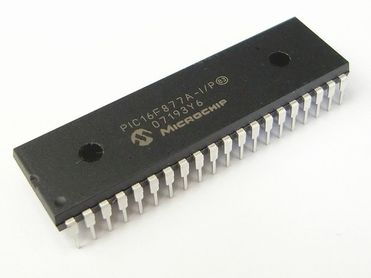
What are PICs
“PIC” refers to a family of microcontroller
PICs range from 8 bit to 32 bit devices
Unlike arduino they lack an easy interface to computers in favor of lower costs
Over 1000+ models of PIC, one for any application

Slide 36
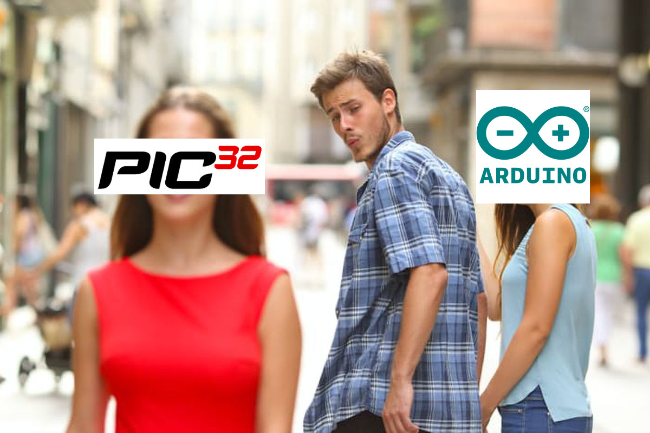
Why use PICs
Extremely low cost, sub one dollar per microcontroller in a large number of cases
Fully complete all inside of the IC (no external oscillator needed)
Extremely low power designs, on the order of microamps during sleep (230 years on two double AA batteries)
Great point for your resume

Slide 37
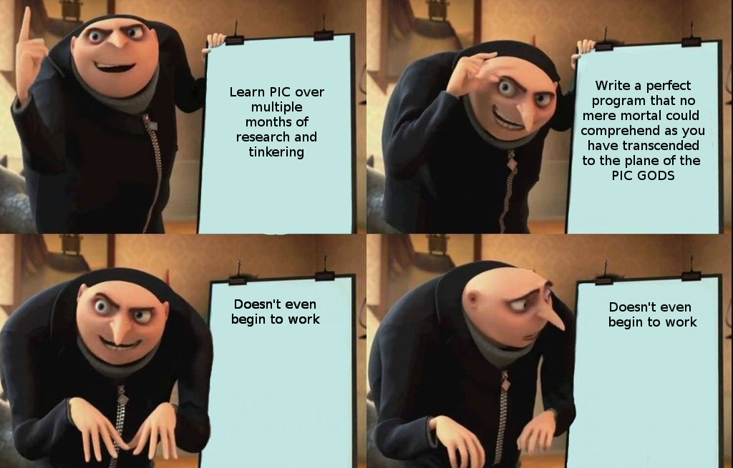
Why not to use PIC’s
Less user friendly than arduino
Less community support than arduino
Generally a pain

Slide 38

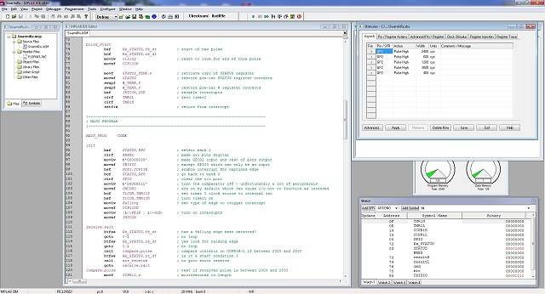
How to develop for PICs
MPLAB IDE developed by microchip
http://www.microchip.com/mplab/mplab-x-ide

Slide 39
How to compile for pics
Microchip publishes compilers and the integrate into MPLAB
http://www.microchip.com/mplab/compilers
MPLAB or the command line can let you compile your c code to a hex file
A hex file is a representation of machine code that is loaded onto the pic

Slide 40
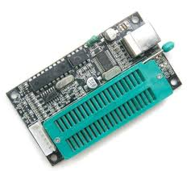
How to program a pic
PIC programmers are $70 and above. Provide support from the manufacturer and debugging capability
Arduino script is free No support No debugging
If you want the free version I’ll have it on github sometime soon or you can come talk to me

